Slide 1
The Zen of Coding
The Coding Bootcamp

Slide 2

Quick Introductions! (30 seconds)
Name
Location
Background (Career, Education, Interests)
Why learn web development?
Excited about class?
Notes:
This class is, after all, about you – so let’s do some introductions.
(You may also want to ask “Fears about class?” – that can turn a little negative, so be ready to dissuade/make happy the students if you do ask this)

Slide 3
Instructor = … ?
Your Name Here
<insert education or experience tidbit>
<insert education or experience tidbit>
Over <#> years coding, (with plenty of experience being a n00b at it.)
Insert image of you here
<personal fact>
Secretly, a <funny fact about yourself>
Insert image here
Notes:
Enough about you, time to talk about me.

Slide 4
Some Cool Stuff I Made…
SNAPSHOT OF SOMETHING
YOU MADE GOES HERE!
Notes:
Here’s this cool thing I built. It does X and it’s important because Y.
Questions?

Slide 5
The Path of Learning
Notes:
It’s important to keep in mind why you joined this class. Let’s talk about your goals.

Slide 6

Your Goals...
New Career
Basically 1000% of you said…

Slide 7
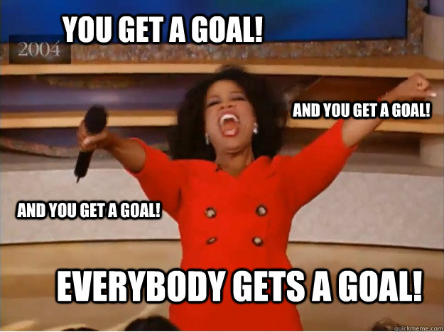
Your Goals...
And why do you want a new career?
To escape a “dead-end job”
To pursue a “dream”
To be able to “create”
To follow a “fascination”
To attain “financial stability”
To attain “financial freedom”
To “challenge” yourself
To be a “role model” for kids

Slide 8
Your Goal = Our Goal
As instructors,
we take your goals very, very seriously.

Slide 9
Support Team
Our Promise:
If you’re willing to put in the time – and you take our advice, we’re here to help you 100% of the way.
This goes for everyone working behind the program:
Instructors
TAs
Student Success Team
Career Coaches
Everyone Else!
Notes:
This program will not be a traditional college class. We're here to support you 100% of the way to really help you achieve their goals.

Slide 10
But Remember…
Nothing good comes easy.
Notes:
There are a few things you can do to ensure your success

Slide 11
On Keys To Success…

Slide 12
Don’t Be This Guy…
Notes:
First off, don’t be this guy.
Those that have the hardest time in the program are not the ones who came in knowing no programming.
It’s not the ones who haven’t played around with HTML, CSS, or Javascript.
It’s the ones who walk in thinking they either A) Know more than they do. Or B) Are experts in a completely different field.
There is something that stops people like this from accepting the reality.

Slide 13

This Should Be You.
Notes:
Be this guy. Having a humble attitude is the first requirement of being successful in this program.

Slide 14
Our Mantra for Today and Beyond…
When it comes to web development…

Slide 15
Our Mantra for Today and Beyond…
I know nothing.
Notes:
Don’t be frustrated! Keep an open mind – you’re here to learn.
You mastery of other subjects, educational backgrounds, and professional successes do not guarantee that you will do well here. The only thing that will guarantee success is hard work, humility, and a relentless desire to be better.

Slide 16
You.
Notes:
You are a blank slate. Seriously. Don’t lose sight of this image. At first it may feel intimidating. Knowing how little you know. But relish the opportunity and take the privileges it comes with.
You have permission to struggle. To fail. To not “get” everything immediately.

Slide 17
The Path of Learning
Notes:
So how does one learn? Well…

Slide 18
Nothing Comes Easy…
As students, you face three
HUGE obstacles!
Notes:
… there are a few obstacles in the way.
Things that will frustrate you…

Slide 19
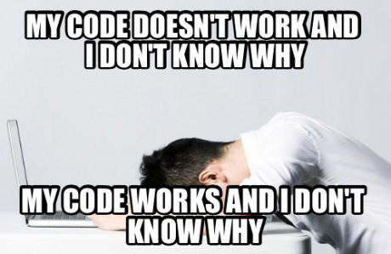
Obstacle #1 – The Great Confusion
Notes:
Obstacle 1 First, learning to code is tough, intimidating, and frustrating at times. You should forget about your uncle/brother-in-law/friend/step-sister who told you about so-and-so learning to build apps in 1 week. Coding is hard. It will take time. There is no way around that.
It’s confusing, difficult, and there’s a ton to learn. But it’s super rewarding when you _do_ learn why your code broke or is working.

Slide 20

Obstacle #2 – The Great Doubt
Notes:
Obstacle 2
There will be many moments where you will doubt yourself.
Everyone is on the same page as you. No-one in this classroom is dumb. You all have varying backgrounds with differing experiences and exposure.
Everyone was where you are at some point in their career. Every single developer. Me too.
It takes time but you have what it takes; you were selected for this program because we know you have what it takes.
The first few weeks will be difficult, but everyone will be on a pretty level playing field a few weeks in.

Slide 21

Obstacle #3 – The Great Distance
Notes:
Obstacle 2 – you have a ton of ground to cover!
There’s a lot to learn, and it can be intimidating. But honestly, 6 months will be over before you know it.
Because of the length of the program, personal issues WILL come up during the course of the program, and it will be challenging to stay motivated.
You should see each other as a family embarking on a long journey. You will become far closer to your peers than you realize. Intensity is no substitute for endurance.

Slide 22
Nothing Comes Easy…
Learning to Code Requires Two Things:
Persisting in the face of something that feels incredibly hard and confusing.
Maintaining the self-confidence necessary to believe that you CAN DO THIS.
Notes:
And will take a while to master. Persisting in general is the #1 hardest thing in this course.
Perhaps tied with having self-confidence (talk about imposter syndrome).

Slide 23
Learning is “Frustrating”
“You can’t tell whether you’re learning something when you’re learning it—in fact, learning feels a lot more like frustration.”
“What I’ve learned is that during this period of frustration is actually when people improve the most, and their improvements are usually obvious to an outsider. If you feel frustrated while trying to understand new concepts, try to remember that it might not feel like it, but you’re probably rapidly expanding your knowledge.”
Jeff Dickey, Author of Write Modern Web Apps with the MEAN Stack: Mongo, Express, AngularJS, and Node.JS
Notes:
Frustration = learning, seriously. Here’s the author of a pretty famous book on the mean stack:
So how do we get through this frustration and actually learn?

Slide 24
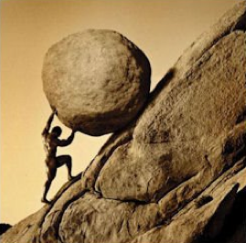
Advice for the Journey
Throughout this course, always remember to:
Work Hard!!

Slide 25
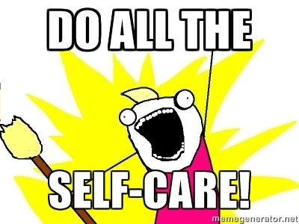
Advice for the Journey
Throughout this course, always remember to:
Work Hard!!
Appreciate your successes

Slide 26

Advice for the Journey
Throughout this course, always remember to:
Work Hard!!
Appreciate your successes
Trust yourself
Notes:
Questions?

Slide 27
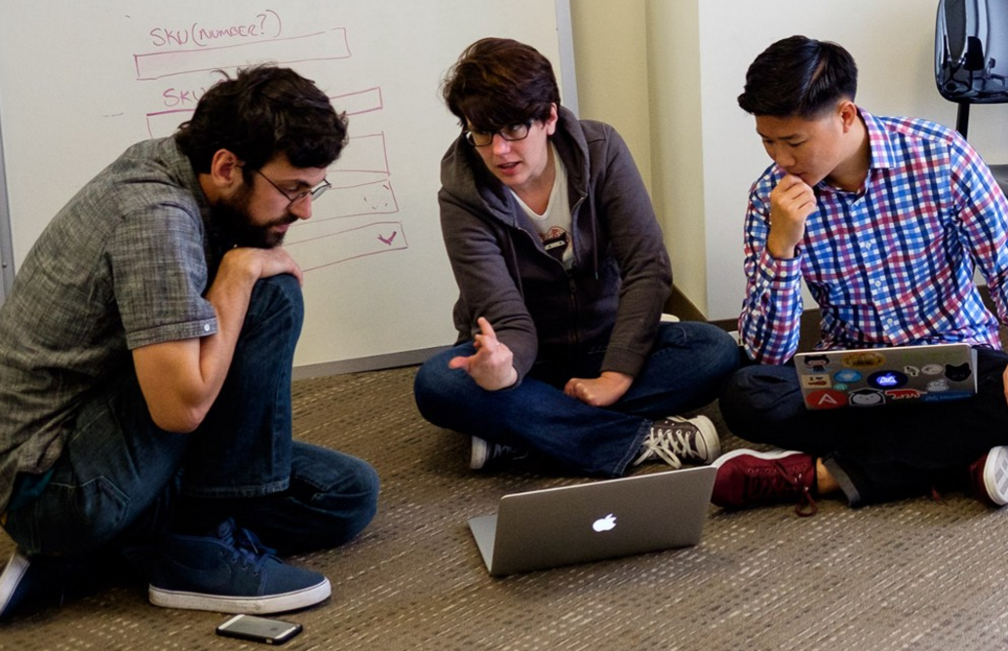
But remember…
If you want to go fast, go alone.
If you want to go far, go in a team.

Slide 28

Google Fu – The Most Important Skill of All
What is Google Fu?
Notes:
Of course, to do this, you’ll need to be great at googling!
This is arguably the best/most important skill you can use.
It’s silly, but being able to find the answers to your questions is extremely important, and people won’t always be around. Google should almost always be your first go-to (it has almost every answer, if you know how to find it).

Slide 29
Course Structure
Notes:
Now that we’ve talked about the journey and how to be successful, let’s talk about the stops along the way.

Slide 30
Daily Schedule
For each class we’ll run through the following:
Set Objectives
Brief Background Lecture
Watch Me / Coding Demos
Code Discussions
In-Class Exercises
Project Work
Notes:
Here’s what our days will look like.
Question: How do you learn to code? (NEXT)

Slide 31
Daily Schedule
For each class we’ll run through the following:
Set Objectives
Brief Background Lecture
Watch Me / Coding Demos
Code Discussions
In-Class Exercises
Project Work
The Super Important Stuff!!!
i.e. Always be coding!
Notes:
By coding! Unfortunate, right?
We’ll get a ton of in-class practice reading and writing code, so the course quickly becomes “code-centric”.
Most days will be much less presentation-heavy than today.
Questions?

Slide 32
Pre-Work
Notes:
So next up I want to spend a little bit of time checking that everyone has everything they need installed (from the pre-work).
If you can check off all of these things, spend this time helping your neighbors. This should become a habit – try to ask for help form your neighbors before going to a TA (you will both learn more along the way). < We’ll talk more about this soon.
That said, let’s check some things off of a list.

Slide 33
Software Checklist
At this point, you should have each of these installed:
Slack
Visual Studio Code
Git for Version Control
Git Bash (Windows) or Terminal (Mac)
Node.js
Heroku-CLI
Google Chrome

Slide 34
Accounts Checklist
You should also now have accounts for:
GitHub (with SSH Integration)
Heroku
LinkedIn
Stack Overflow

Slide 35
Self-Check
Let’s do some quick checks of the following
Visual Studio Code Check
Git Bash / Terminal Check
Node Check
Git Check
Heroku Check

Slide 36
On the Modern Web

Slide 37

Full-Stack Development?
Notes:
So what exactly does it mean to be a “full stack developer?”

Slide 38

The “Magic” of YouTube
Notes:
Let’s use YouTube as an example. (Go to YouTube and do basic search)
You’ll learn all of this in time, but a basic YouTube search requires two things:
A ”frontend” – the graphical user interface which responds to what I type
A “backend” – the code on the “server side” that is able to do the logic behind the search, find the relevant videos, and send them along
(Go to next slide)

Slide 39
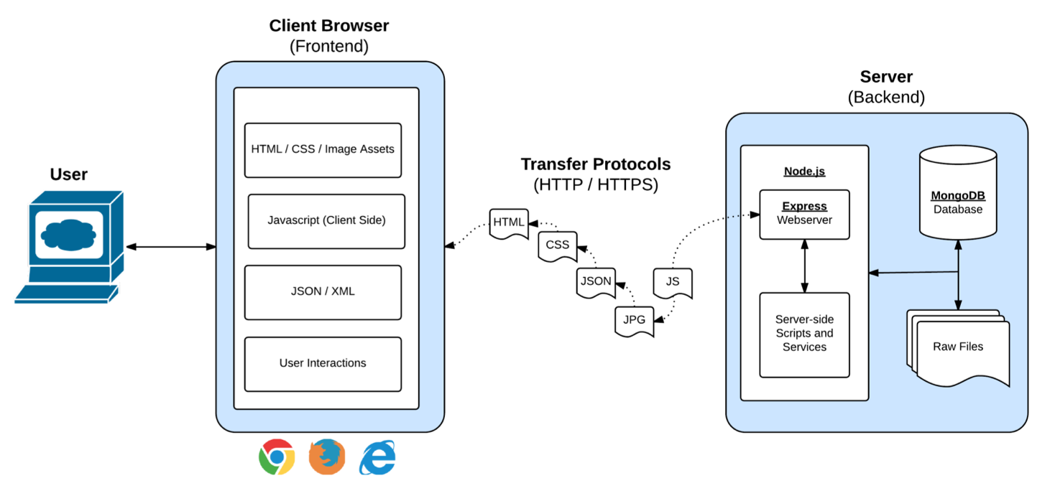
Full-Stack Development
In modern web apps, there’s a constant back-and-forth communication between two key components: the visuals displayed on the user’s browser (frontend) and the data and logic stored on the server (backend).
Notes:
Websites today are all about reading code for these components – “frontend” and “backend”

Slide 40
Full-Stack Development
Full-Stack Development is the concept of building every aspect of the web application – from the visuals and interactions, to the data transfer and processing.
Notes:
That is “Full-Stack Development” – you build can and will build the whole thing.

Slide 41
Full-Stack Development
The Browser
Dev Tools
Server Side
HTML
CSS
JavaScript
jQuery
Bootstrap
SEO
Heroku
Git
GitHub
Templating Engines
Sessions
Writing tests
Node.js
Express.js
Creating APIs
MVC
User Authentication
ORM (Sequelize)
Databases
MySQL
MongoDB
API Interaction
APIs (Consuming)
JSON
AJAX
Real Time Cloud Database via Firebase
Algorithms
Design Patterns
CS Fundamentals
Cutting Edge Development
React.js
Notes:
In this course, you’ll learn everything you need to be able to do this –
you’ll be able to build complex web applications even as a single developer.
Questions?

Slide 42
Let’s Get Crackin!

Slide 43

Intro to Console / Terminal
Notes:
The terminal is the portal to your computer – it allows you to run and even script commands that can create files, folders, and more.
It is extremely important that you get intimately familiar with the terminal as soon as possible, as you’ll use it for almost everything. It is fast and powerful.
NEXT

Slide 44
INSTRUCTOR DEMO
Instructor: Demo
(01-ConsoleCommands)
Notes:
So let’s run through a couple of examples.

Slide 45
> YOUR TURN!
Activity: Get Situated | Suggested Time: 1 min
Assignment:
Make a folder on your desktop named code.
Put all of your code that you do inside of that folder.
Best Practices:
Always use lowercase for folder and file names.
Never put in spaces in your folder and file names.
Use dashes to separate.
Notes:
Your turn!

Slide 46
> YOUR TURN!
Activity: Console Commands | Suggested Time: 12 min
Assignment:
From the Terminal / Console and using only the command line, create:
A new folder with the name of first_day_stuff.
A new HTML file with the name of first_day.html.
Open the current folder containing the new HTML file.
Bonus:
Create multiple directories/folders with the names one_folder and second_folder in one command.
Create multiple files with the names one.html and two.html in one command in the first_day_stuff directory.

Slide 47

Intro to Console
Discuss with Neighbors
Notes:
Re-ask the questions after a couple of minutes walking neighbor-discussion:
How do you create a new folder?
How do you create a new file?

Slide 48
Hello, HTML
Notes:
Now that you can create HTML files from the terminal, let’s create one and actually write some HTML.

Slide 49


<title> Intro to HTML </title>
HTML is one of the three base languages behind every single website.
It defines all of the basic content and a bit of formatting.

Slide 50
> YOUR TURN
Assignment:
In a new HTML file, create the basic structure of an HTML document and include the following in it:
DOCTYPE declaration.
Head tag with a title tag.
H1 tag with a title of your choice.
Embed an image.
Create the following three links on your page:
One link that is target="_blank" so that it opens a new tab when clicked on.
Make the second link bold.
Make the third link a placeholder so it goes nowhere.
Bonus:
Create an ordered list of steps to make a sandwich.
Create an unordered list of 5 bands/musicians you like.
Create a table with 2 columns (animal class and animal name) and 4 rows of animals.
Use an alternate way of separating links without line breaks.
Embed a YouTube video of your favorite band/musician.

Slide 51

YouTube Video Walkthrough!
https://www.youtube.com/watch?v=ieb6Svbc10E&index=1&list=PLgJ8UgkiorCnMLsUevoQRxH8t9bt7ne14

Slide 52

<title> Intro to HTML </title>
How’d it go?

Slide 53
LUNCH (30 Mins)

Slide 54
What / Why Git?

Slide 55
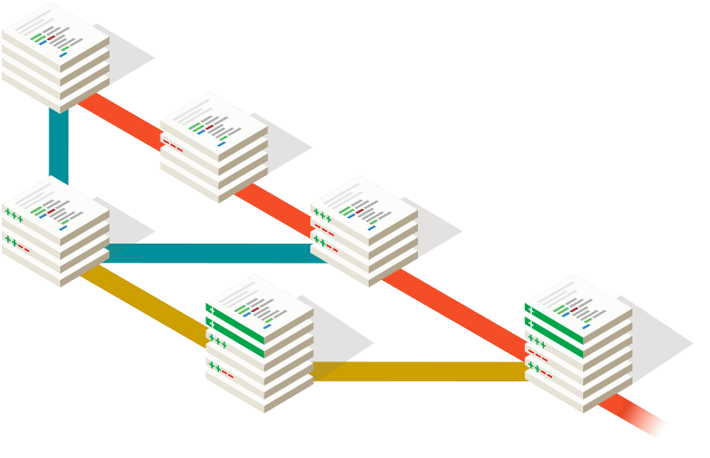
Collaborative Coding
Modern web development is highly collaborative.
Teams are often extremely large and separated across the country — or planet.
Apps sometimes comprise hundreds or even thousands of files.

Slide 56
Let’s Think About It…
What could go wrong?

Slide 57

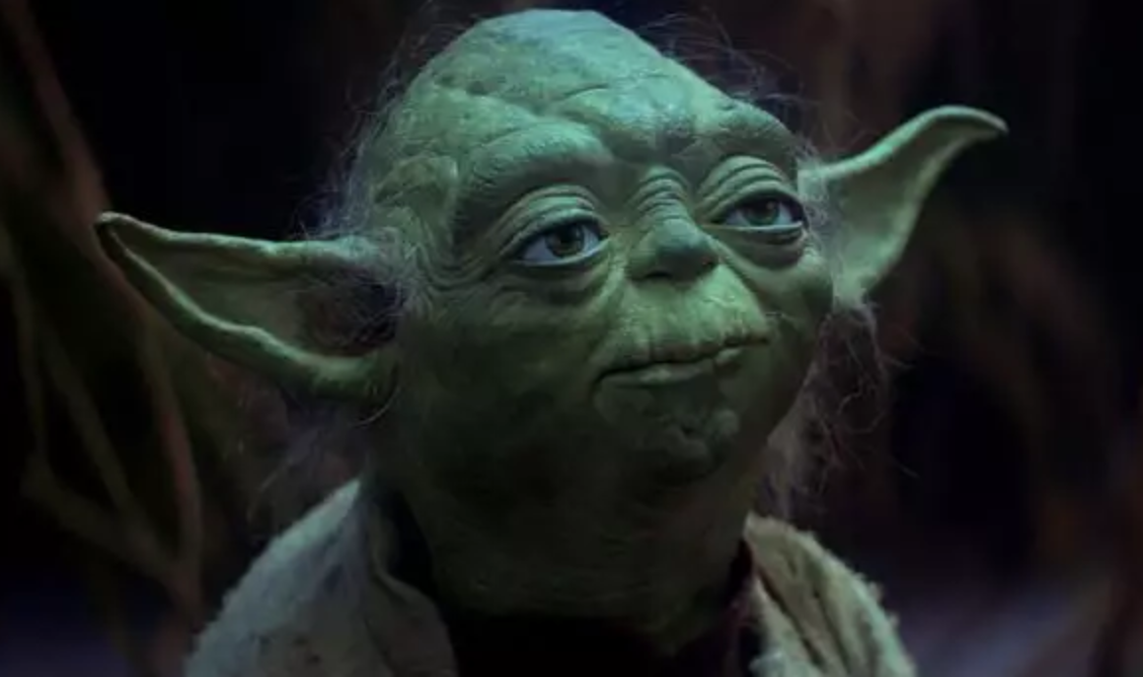

The Group Project
Lesson:
You should use Version Control.
….and watch your teammates’ work
Through the Git, things you will see. Other branches. The future… the past…
…You will find only what you commit.

Slide 58
Version Control
Git Version Control: Provides an organized system for managing code when multiple developers work on a project
at the same time.
The Benefits of Git:
A process for resolving conflicts in code.
Version History.

Slide 59



The Group Project
Master Branch
Let’s say Yoda, Leia, and Han are all working on different branches for Google.
‘Branch’ = personal copy
Feature branch
Yoda - Maps branch
Leia - Translate branch
Han - Styles branch

Slide 60
The Group Project
If Leia, Yoda, and Han are all working on different branches, they can work separately without affecting each other’s code.
If Yoda added a Maps feature and Leia wants to use this new feature in his code, all Leia has to do is merge in the new version of Yoda’s branch into her own branch and keep coding! (This is much better than the alternative of copy and pasting files)
Always pass on what you have learned.

Slide 61
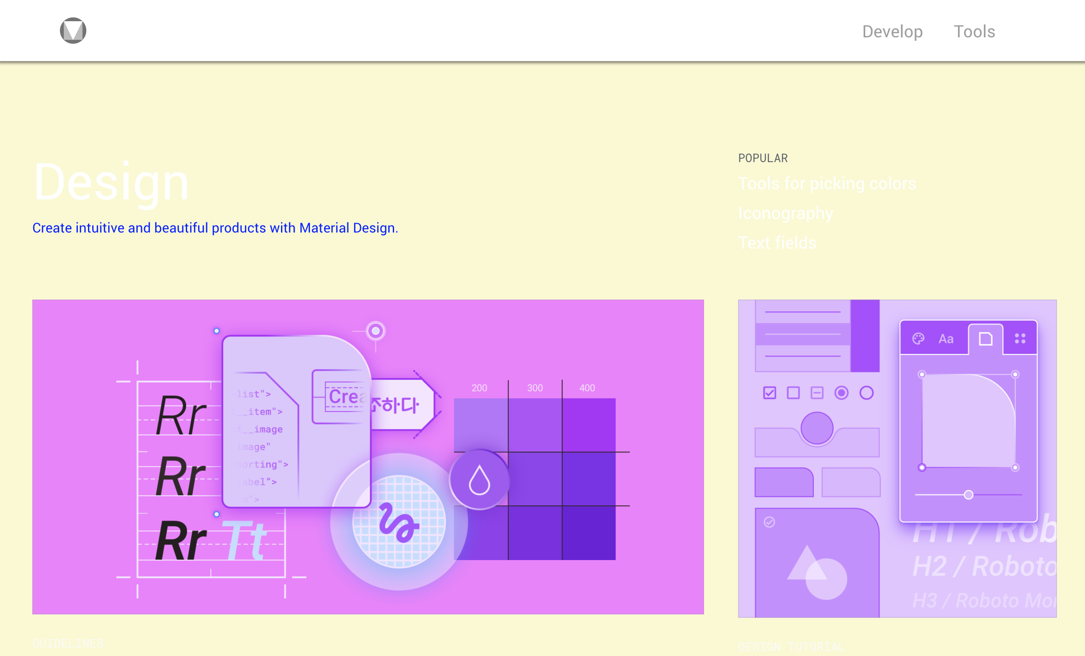

The Group Project
Let’s say Han was working on a site-wide change in styling, but one of his changes had unintended consequences on a page Leia was working on.
Instead of having to debug the problem while users stare at a broken page, Git makes it easy to instantly revert or “rollback” the mistake.
New Broken Version
Old Working Version
Revert

Slide 62
The Group Project
Lesson:
You should use Version Control!

Slide 63
Quick Activity!
Suggested Time: 3 min
Turn to your neighbor, and have one of you explain to the other:
The concept of version control.
Then the other should explain:
Two of the key advantages to using a version control system.

Slide 64

So… What’s this GitHub?
GitHub is a Web-Based hosting service to store code online.
It allows developers to pull (download) code or push (upload) code to the same repository (directory).
It also allows developers to view histories of code changes and to track issues.

Slide 65
So… What’s this GitHub?
GitHub also serves as a social network for developers and their code.
It allows developers to freely contribute to open source projects and discuss issues/features.

Slide 66
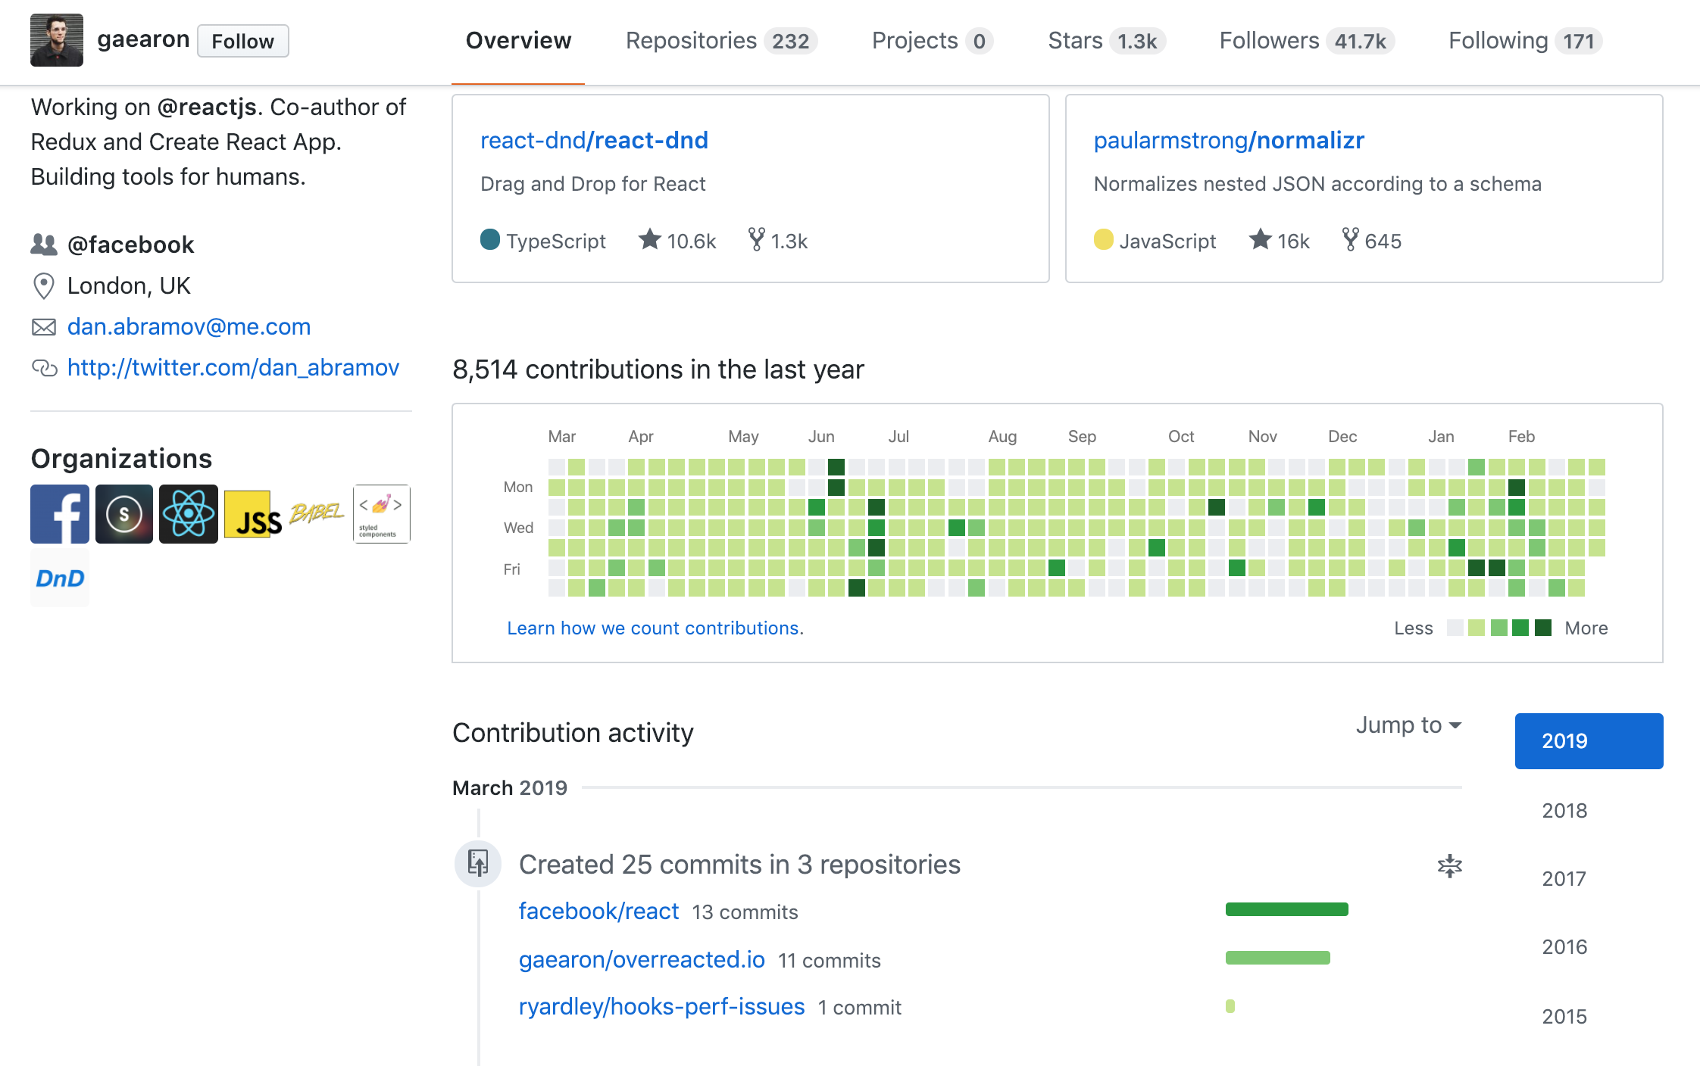
So… What’s this GitHub?
GitHub is a great way to showcase your work.
Hiring managers check GitHub activity and samples to evaluate candidates.
Seeing regular activity shows recruiters that you're continuously learning and developing.

Slide 67




To Sum It Up…
• Think of GitHub like Dropbox for Git. It serves as a backup for your repository and allows you to share your code with other people.
One big advantage GitHub has over a tool like DropBox is that there are many builtin tools to help with developers with collaboration.
• Remember, both Git and GitHub aren’t tied to specific programming languages. For our purposes, we’ve been using code examples, but they could just as easily be image files or PowerPoint presentations.

Slide 68
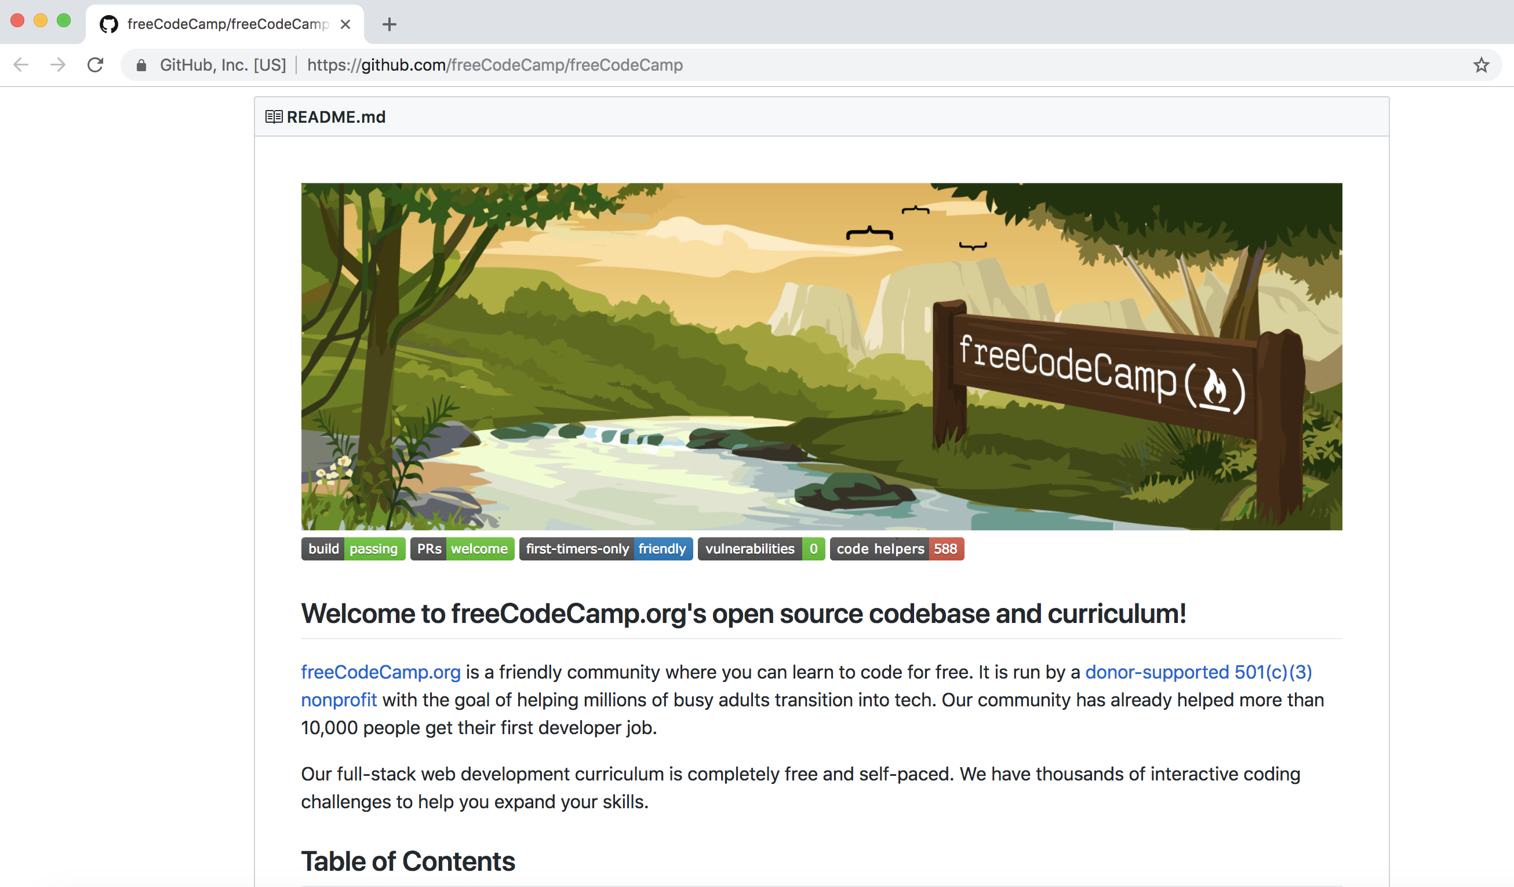
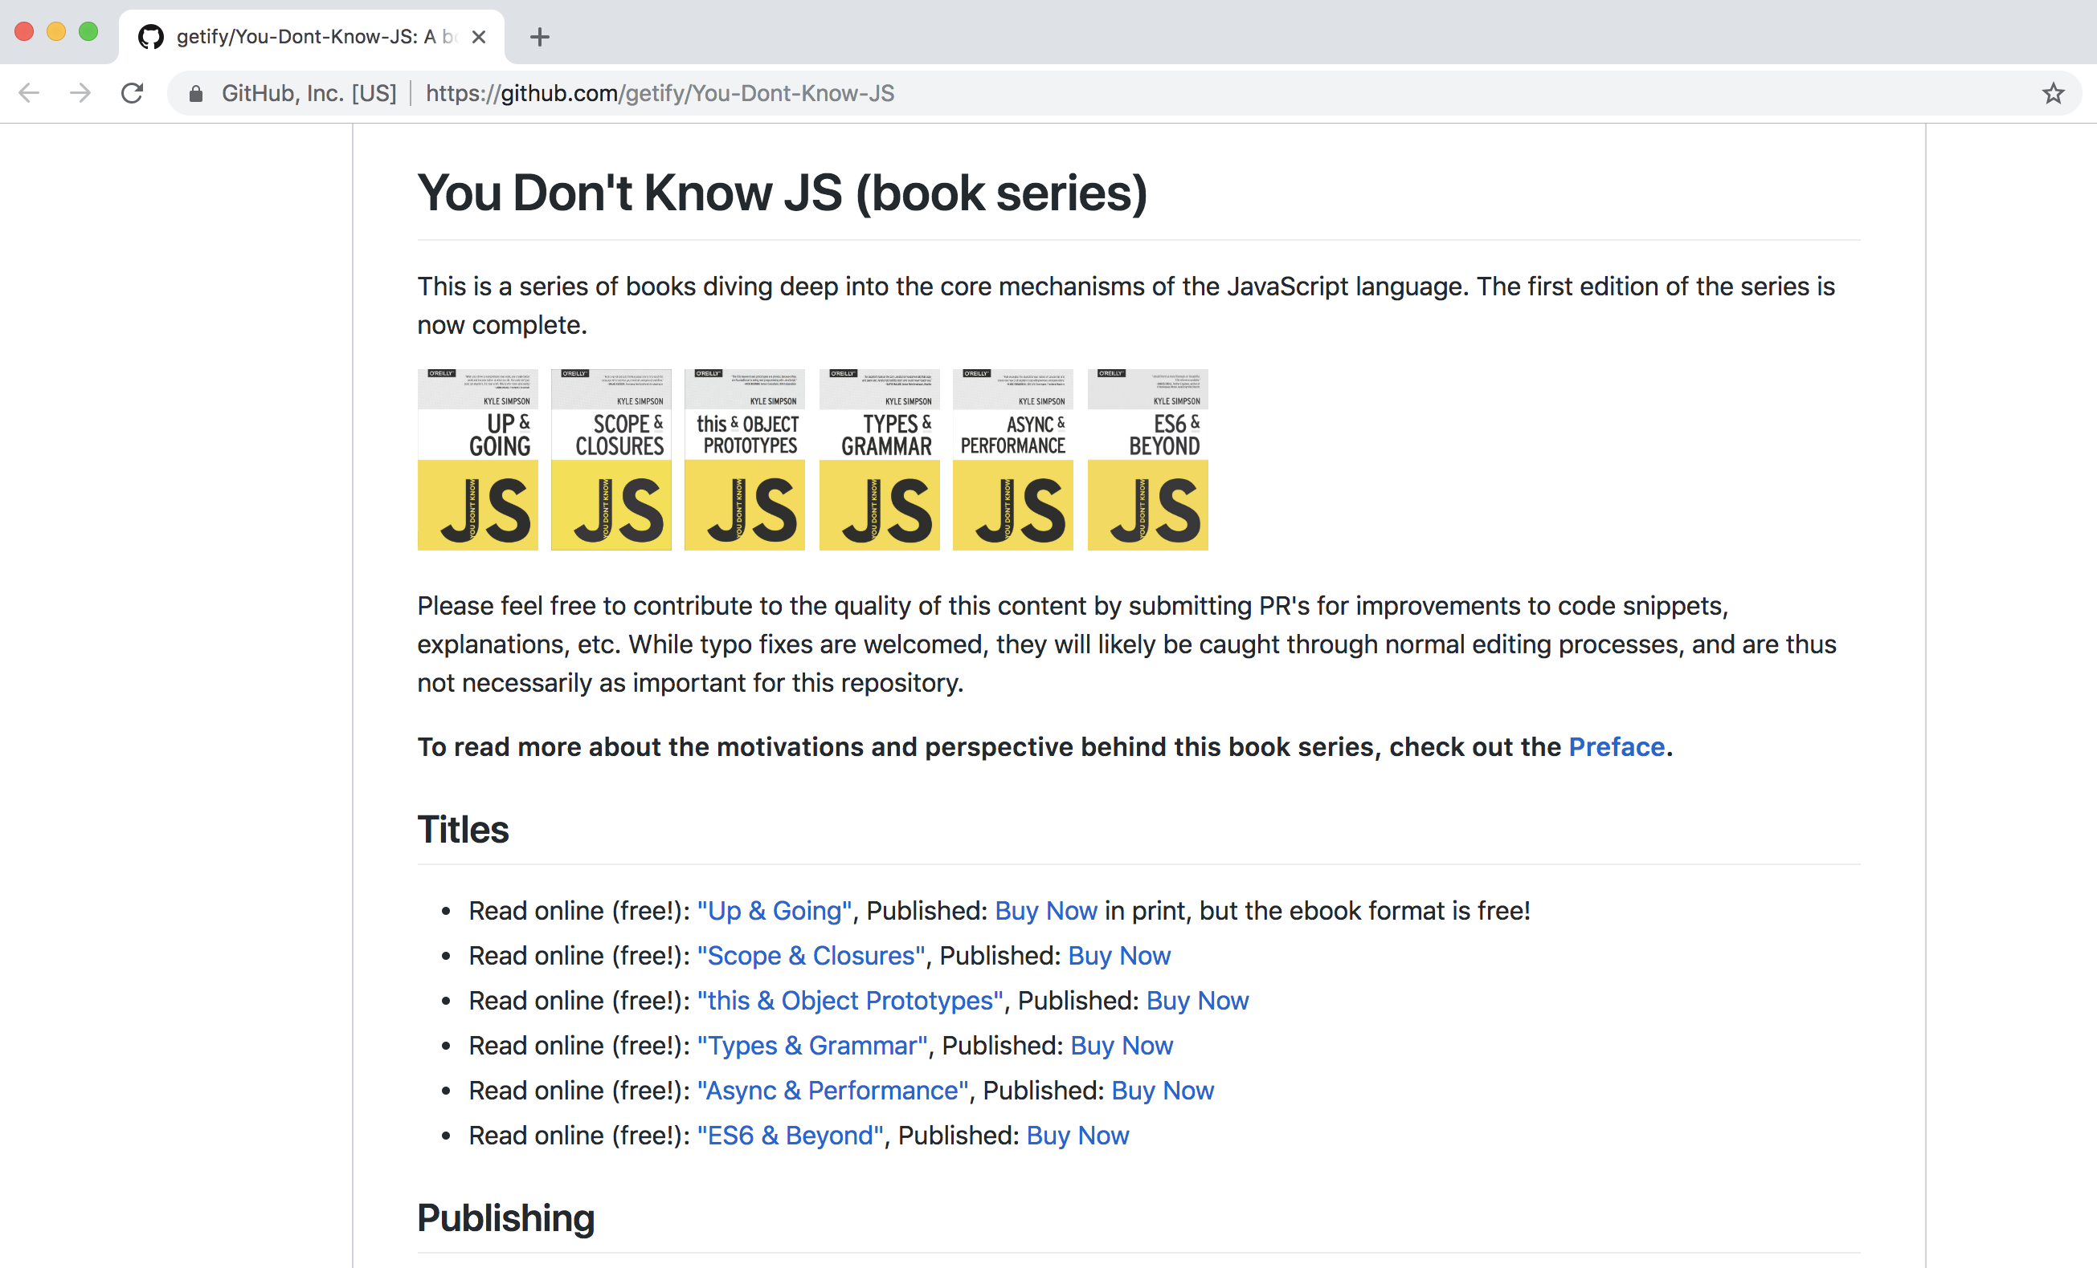
GitHub Examples
Repos…
Repos everywhere…

Slide 69
Get Started with Git

Slide 70
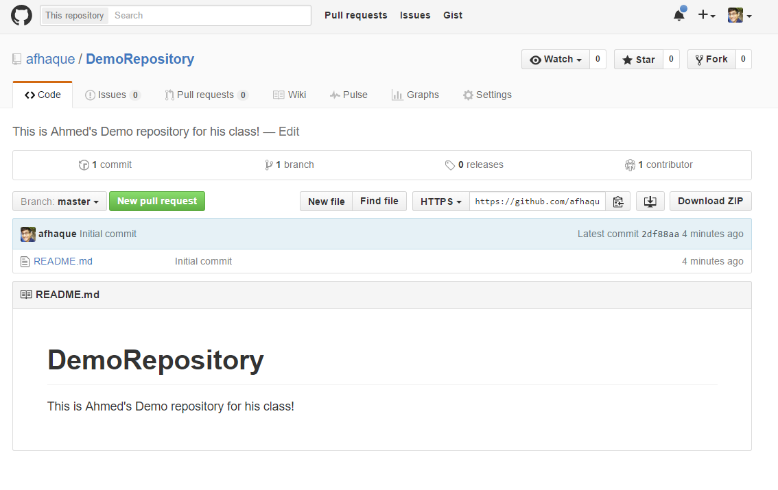
Instructor Git Demo!

Slide 71
Basic Git Commands
At its most basic, these are the five git commands to get started:
git clone
git add
git commit
git push
git pull

Slide 72
Basic Git Commands
At its most basic, these are the five git commands to get started:
git clone – copies an entire repo, while establishing a connection between a local and remote repo.
git add – tells git to track one or more files.
git commit – notes a change to the local repo.
git push – sends changes to a remote repo.
git pull – downloads freshest version of the repo (from a remote repository) into the local repo.

Slide 73
> YOUR TURN!
Activity: Git Add, Commit, Push | Suggested Time: 15 min
Assignment (Using GitHub and the command line):
Create a new public GitHub repository and name it whatever you like. Be sure to check the box for “initialize this repository with a README.”
Next, clone the repo to your local directory.
Then create an HTML file inside the local directory.
Add, Commit, and Push the code to GitHub.
Bonus:
Create a new public GitHub repository, and name it `zen-garden`.
Go to CSS Zen Garden (http://www.mezzoblue.com/zengarden/alldesigns/). Navigate to a few of the examples and choose a page that you like.
• Download the HTML/CSS, add it to your new repo, and change the CSS in any way you'd like.
• Add, Commit, and Push the code to GitHub.

Slide 74
Git Workflow

Slide 75

The .git Folder
• When you cloned your repo, you might have noticed a hidden .git folder was created.
• This folder stores information about your repository, including a history of all changes, along with who made them.
This is what makes your local directory a repo, as opposed to a regular folder.

Slide 76
Git Workflow
In Git, there are four conceptual areas your code can be in.
Local
Repository
(HEAD)
Remote
Repository
Staging Area
(index)
Workspace
git add
git commit
git push

Slide 77


Workspace
The workspace is where you’re used to dealing with your files.
Any time you save a file, you’re replacing the old version of a file with a new one.
This step is referred to as Untracked since Git has no knowledge of your workspace.

Slide 78

Setting the Stage
• git add - Adds a file to the Staging Area.
This command takes an argument, which means we must provide the name of the file we want to add. Ex: git add myFile.md
Since we want to add all the files in our directory, we’ll give it the option -A. Ex: git add -A

Slide 79
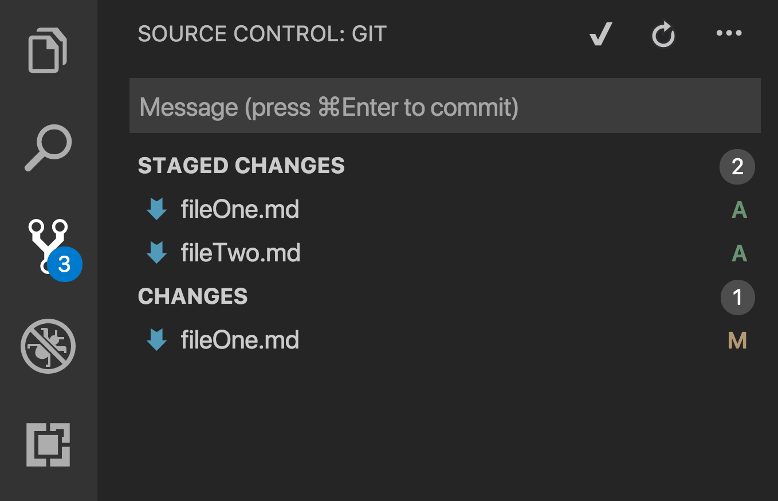
Setting the Stage Continued
These files have been staged with git add, but not committed.
This file has been changed (and saved) since it was staged.
We should probably run git add -A again.

Slide 80
Keeping It Local
To add files to the local repository, run git commit
This command takes the files from your staging area and adds them to the history kept in the .git folder.
git commit -m “Fixed a bug that caused a 403 error”

Slide 81


The Remote Repository
Lastly, we add our local repo to our remote repo with git push.
• Once things are pushed up to GitHub, GitHub will have a history of every change you’ve committed, along with any changes your teammates have pushed to the repo.
Remote Repo
Leia’s Local Repo
Luke’s New Repo
git push
git clone
Translate Branch
Translate Copy

Slide 82
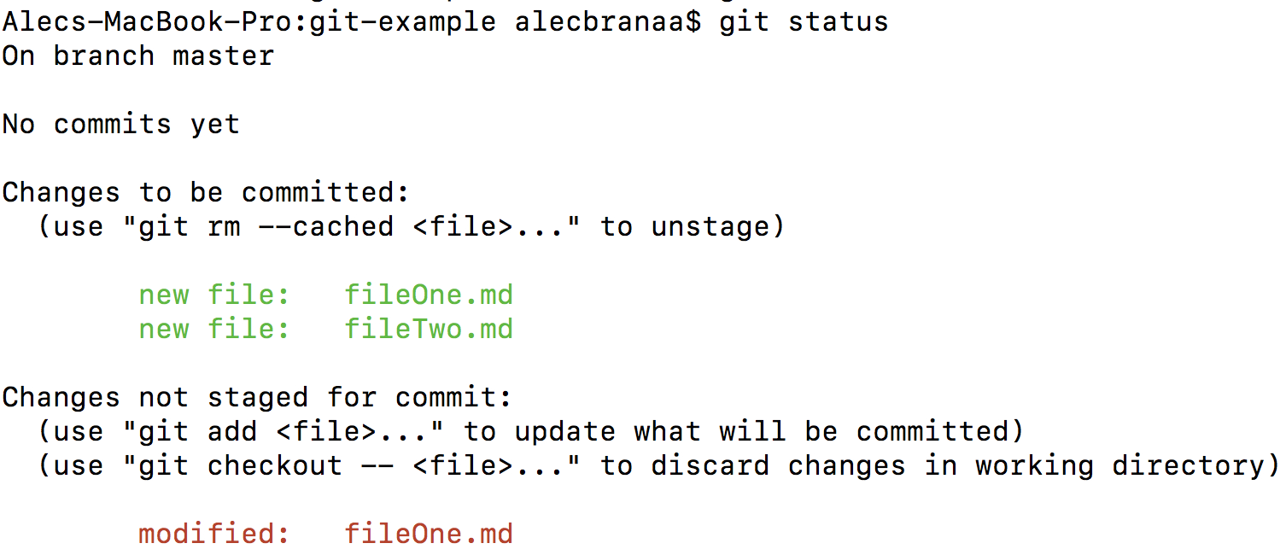
Still a Bit Lost? Never Worry!
• Remember that you will use these concepts every day.
It’s most important that you familiarize yourself with the 5 basic git commands.
• If you’re ever in the middle of making changes and want to see what step you’re at, run git status.

Slide 83

Still a Bit Lost? Never Worry!
Follow the handy pdf guide provided to you!
Practice a few times on your own before our next class.

Slide 84
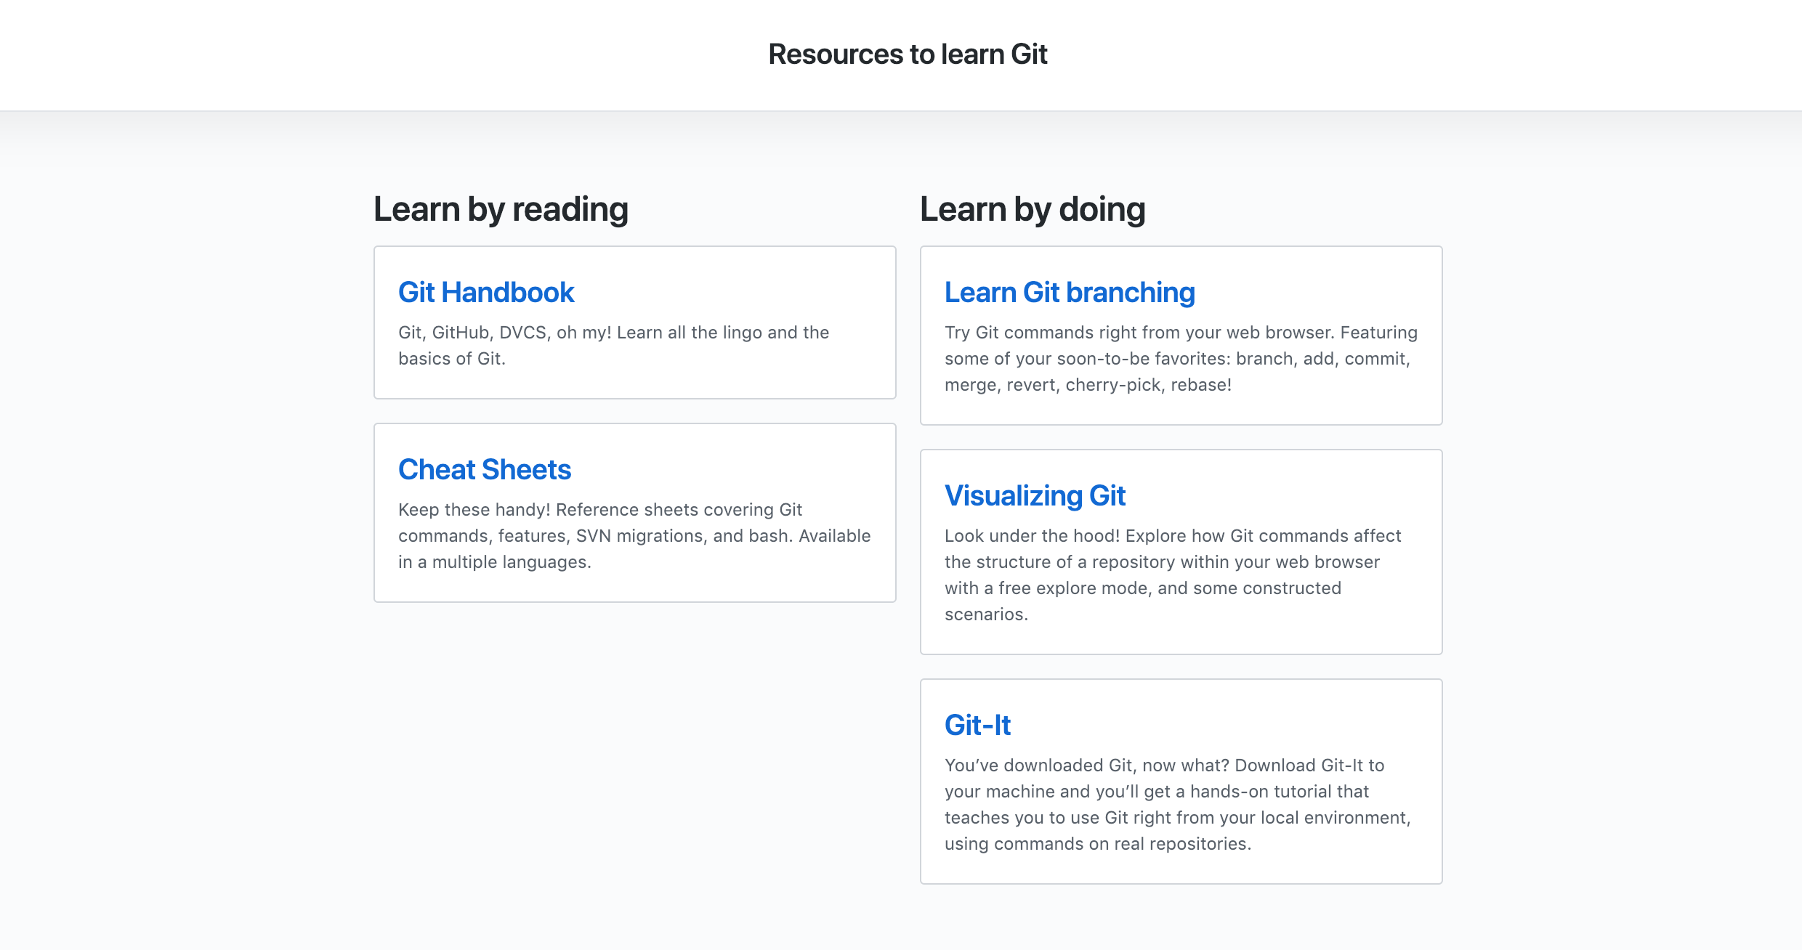
If You’re Still Lost… Here’s Some (Free) Resources
https://try.github.io/

Slide 85
HTML Round 2

Slide 86
HTML Syntax (Basic)
Content
<h1>
This is Mah House
</h1>
Opening Tag
Closing Tag

Slide 87
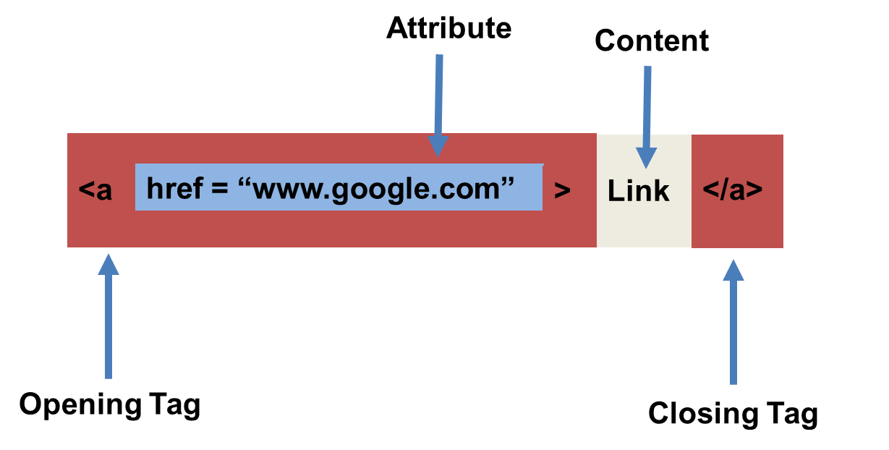
HTML Syntax (with Attribute)

Slide 88
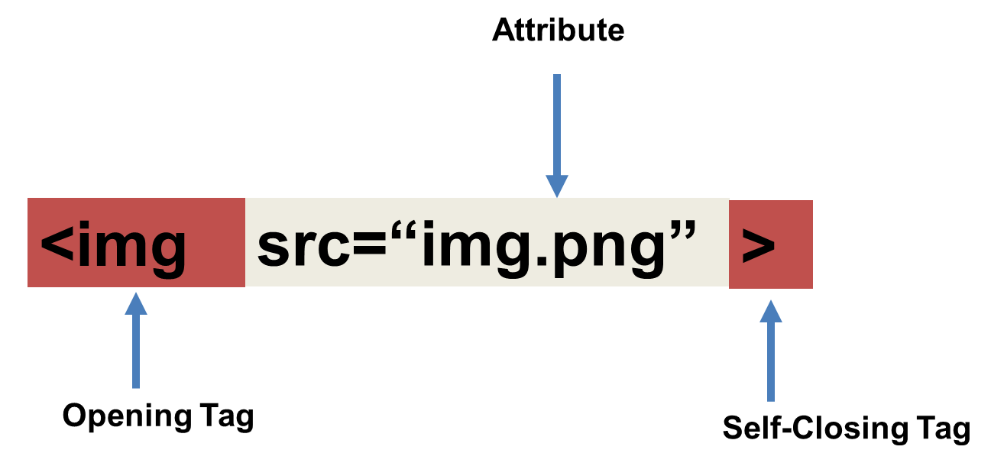
Tricky Tags (Self-Closing)

Slide 89
Important Common Tags
Headings:
<h1> </h1> - Heading 1 (Largest Heading)
<h2> </h2> - Heading 2 (Next Largest Heading)
<h3> </h3> - Heading 3
…
Containers:
<html> </html> - Wraps the entire page
<head> </head> - Wraps the header of the page
<body> </body> - Wraps the main content
<div> </div> - Logical Container ***
<p> </p> - Wraps individual Paragraphs
Others:
<strong> (bold), <em> (emphasis)
<img> (images), <a href> (links), <li> (list items) , <title> (title), <br> (line break), <table> (tables), <!-- --> (comments)

Slide 90
Less Common Tags
All HTML Tags are listed here: http://www.w3schools.com/tags/
Don’t try to memorize them! Simply refer back to documentation as needed.
Other tags:
<video> for Videos
<audio> for Audio files
<embed> for Embedded files
<code> for including computer code
<header> for headers
<nav> for navigation bars
<footer> for footers

Slide 91
HTML for Forms
Common UI (User Interface) Form Elements:
<form> - Creates a form section in HTML
<input> - Input boxes
<label> - Labels for boxes
<button> - Button
<textarea> - Large textbox

Slide 92
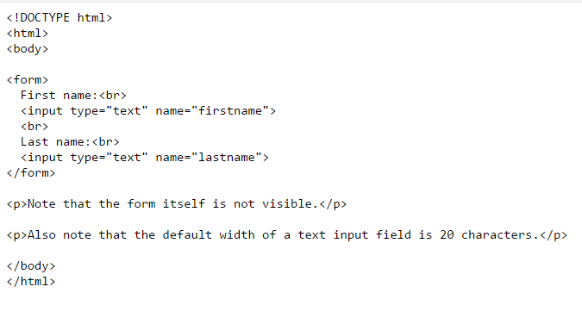
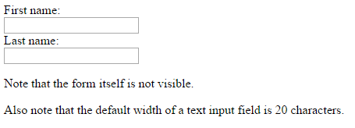
HTML for Forms

Slide 93
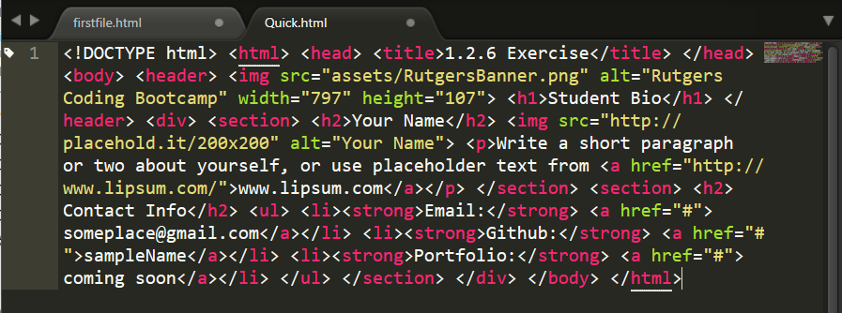
On Ugly HTML
Don’t do this… Use proper indentation and sectioning.
Readable code is easier to maintain.
Invest time to get better about this now. It will pay dividends!

Slide 94
> YOUR TURN!
Activity: 1-HTML_Git | Suggested Time: 20 min
Assignment
In this activity, you’ll create a student bio using HTML. You will then add, commit, and push your completed HTML to GitHub for the world to see.
Additional instructions, sent via Slack.

Slide 95
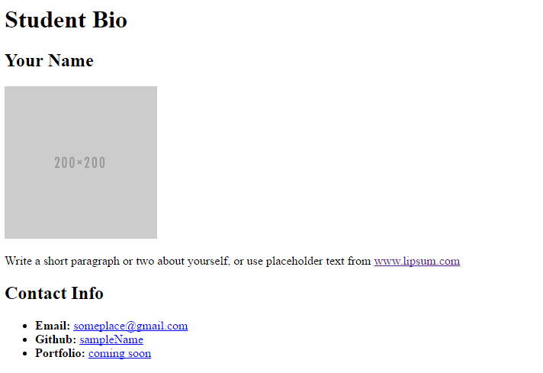
> YOUR TURN!

Slide 96
CSS Stylin’

Slide 97


HTML / CSS Definitions (*yawn* unimportant)
HTML: Hypertext Markup Language – (Content)
CSS: Cascading Style Sheets – (Appearance)
HTML/CSS are the “languages of the web.” Together they define both the content and the aesthetics of a webpage – handling everything from the layouts, colors, fonts and content placement. (JavaScript is the third – handling logic, animation, etc.)

Slide 98


HTML / CSS Analogy
HTML Alone
Like writing papers in “Notepad.”
Can only write unformatted text.
HTML / CSS
Like writing papers in Microsoft Word.
Can format text, page settings, alignment, etc. based on “highlighting” and menu options.

Slide 99
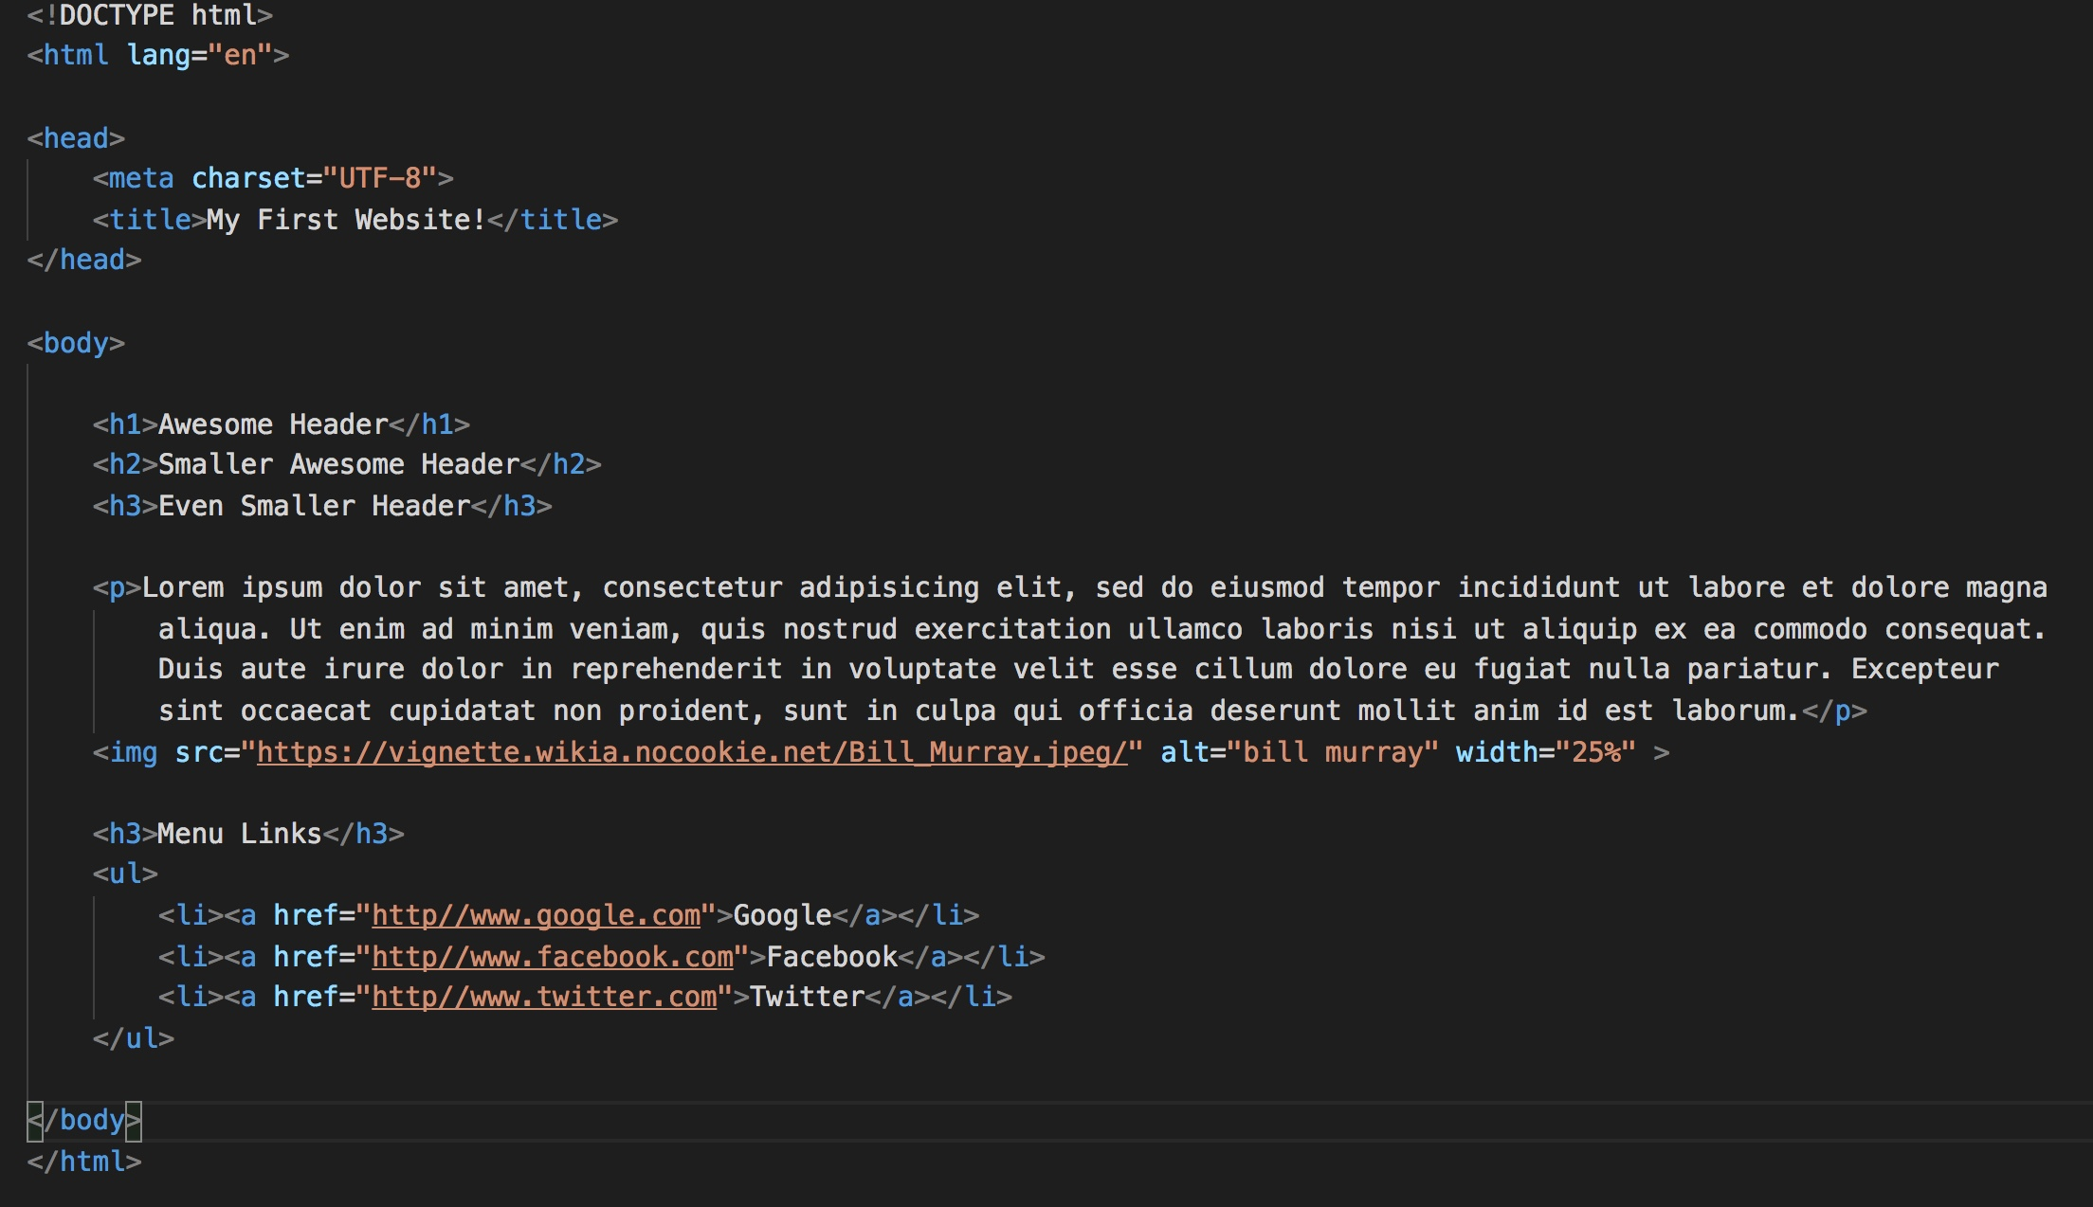
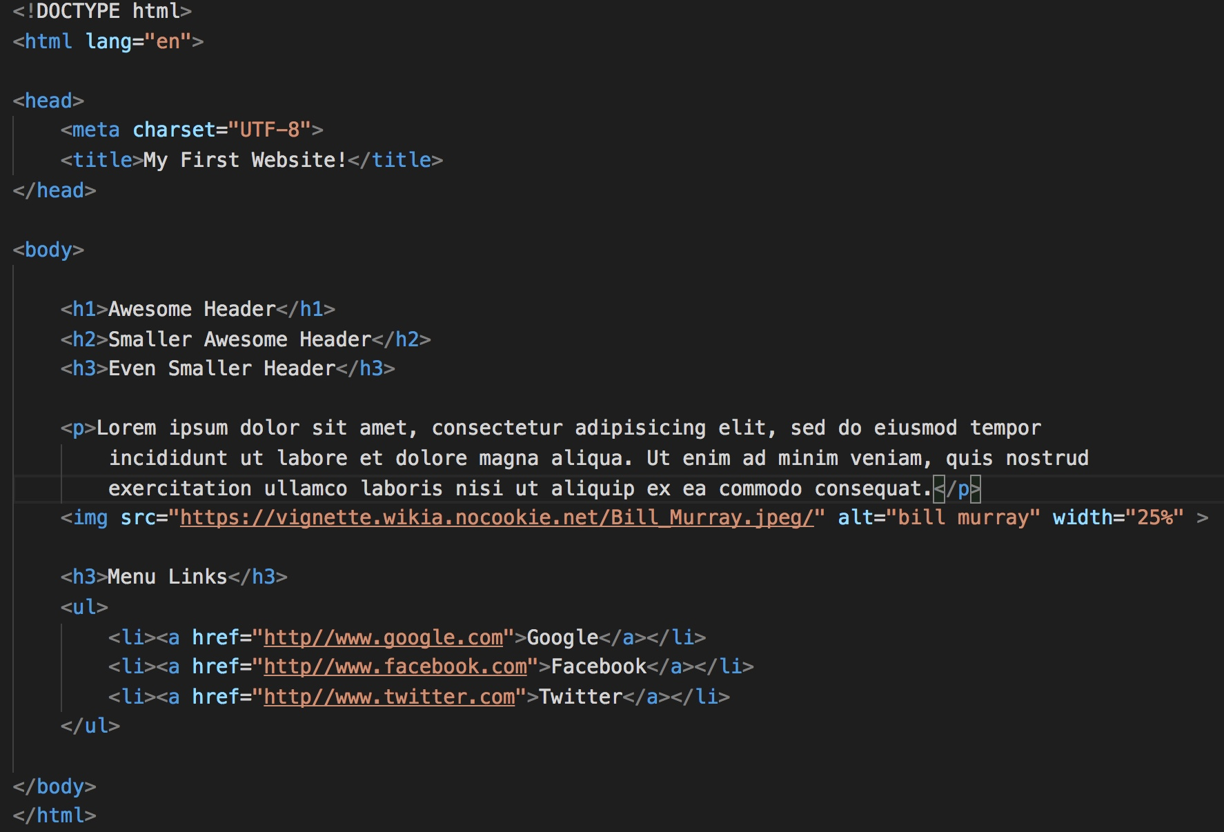
Basic HTML Page

Slide 100

Basic HTML Page - Result

Slide 101
Basic HTML Page - Result
Hella Boring…

Slide 102
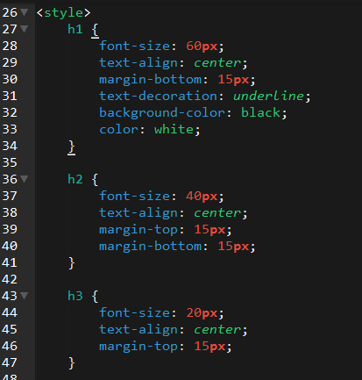
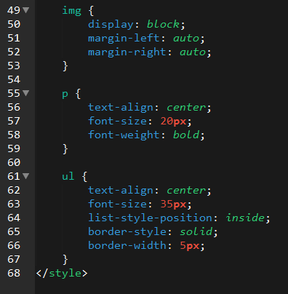
Enter CSS

Slide 103

Enter CSS - Result

Slide 104

CSS Syntax
CSS works by hooking onto selectors added into HTML using classes and identifiers.
Once hooked, we apply styles to those HTML elements using CSS.

Slide 105
CSS Example
In the below example the “Header” would be turned blue and MUCH larger because of the CSS.
We can incorporate an element’s class or ID to apply a CSS style to a particular part of the document.
Just remember to include the necessary symbol before the CSS: “.” for class, “#” for ID.
Example (HTML):
<p class=“bigBlue”>Header</p>
Example (CSS):
.bigBlue
{
font-size: 100px;
color: blue;
}

Slide 106
Key CSS Attributes
Font / Color:
color: Sets color of text.
font-size: Sets size of the font.
font-style: Sets italics.
font-weight: Sets bold.
Alignment / Spacing:
padding (top/right/bottom/left): Adds space between element and its own border.
margin (top/right/bottom/left): Adds space between element and surrounding elements.
float: Forces elements to the sides, centers, or tops.
Background:
background-color: sets background color.
background-image: sets background image.

Slide 107
Powerful Duo
Believe it or not, HTML / CSS is all you need
to develop a vivid, full-blown website.

Slide 108
INSTRUCTOR DEMO
Instructor: Demo
(quickexample_internalcss.html | 2-BasicCSS)

Slide 109
> YOUR TURN!
Activity: 3-HTML_CSS_Layout | Suggested Time: 20 min
Assignment
In this activity, you’ll upgrade your previous HTML bio-page using CSS style rules. Once you’re done, commit and push up your changes to GitHub.
We’ll send you additional instructions via Slack.

Slide 110
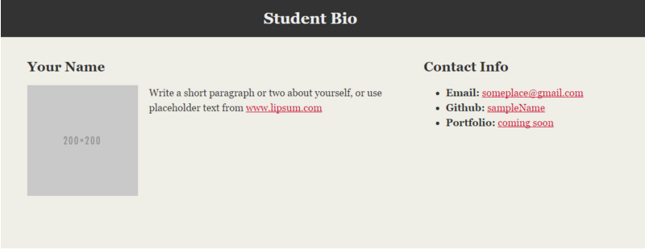
> YOUR TURN!

Slide 111
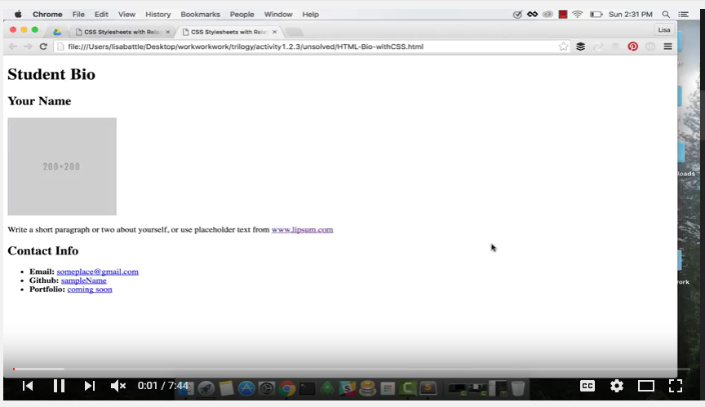
Video Walkthrough!!
https://www.youtube.com/watch?v=kMBinXTCrXI&list=PLgJ8UgkiorCnMLsUevoQRxH8t9bt7ne14&index=2

Slide 112

Still a Bit Confused?
Remember! We’ve got video guides for key activities like that last one.
If you feel like you are EVER falling behind, use those online walkthroughs to help catch back up. They are made to be easy to understand.
Still having trouble? Shoot your instructor or one of your TAs a message!
We are here to help you out in whatever way we can!

Slide 113
Homework!

Slide 114
Homework “Due”: This Week
By Next Class You Should:
Figure out where the GitHub Repo is for our class.
Re-do the Terminal example from class today.
Re-do the HTML example from class today.
Watch the Walkthrough Video if you felt a bit lost.
Review the Git commands we learned and how to use them

